Slide 2
Everyday Probabilistic Data Structures for Humans
Yeshwanth Vijayakumar
Project Lead/ Architect – Adobe Experience Platform

Slide 3
Goals
Add some interesting tools to your data processing belt
Show how to use the tools and apply it
Not in Scope
Internals of the Data Structures
Much better resources out there than me ☺

Slide 4
Daily Trade Offs
Cost
Latency
Accuracy

Slide 5
An example : Rainforest Inc.

Slide 6
Simplified Example Workflow
Visit Product Page
Add To Cart
Purchase

Slide 7
Event
Significant Fields In each event
productId
eventType
PageVisit
AddToCart
Purchase
userId
totalPrice
sellerId
ipAddress

Slide 8
Scale of Events
Product Catalog Size : 1 Million
Users : 50 Million
Events per day : 100 Million
Average Events per Second: 1k per second
Size of Daily Events Data: 1 TB

Slide 9
Some Interesting Questions
Has User visited this product yet?
How many unique users bought Items A , B or C
How many items has seller X sold today?

Slide 10
What are we going to trade off?
Cost
Latency
Accuracy

Slide 11
Probabilistic Data Structures

Slide 12
Which ones are we going to explore?
Bloom Filters
Hyper Log Logs
Count-Min Sketches

Slide 13
Bloom Filters

Slide 14
Bloom Filter TL;DR
Answers Set Membership in a probabilistic way
Use for Set.exists(key)
Is the element I am looking for possibly in the the Set?
If yes? What’s the probability that the answer is wrong?
If the answer is NO, you definitely don’t have it in the Set
Loss free Unions (provided they are of same size and config)

Slide 15
Monoids?
Getting to the distributed nature of our computation
Given a set M and an operation op
Closure: x op y ∈ M
E.g. str(a) + str(b) = str(ab) ∈ String
Associativity: (x op y) op z = x op (y op z)
str(a) + ( str(b) + str(c) ) = ( str(a) + str(b) )+ str(c) = str(abc)
Identity: There exists an e ∈ M such that e op x = x op e = x
str(a) + str(””) = str(“”) + str(a) = str(a)

Slide 16
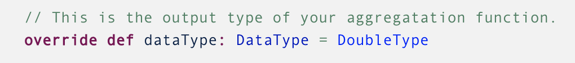
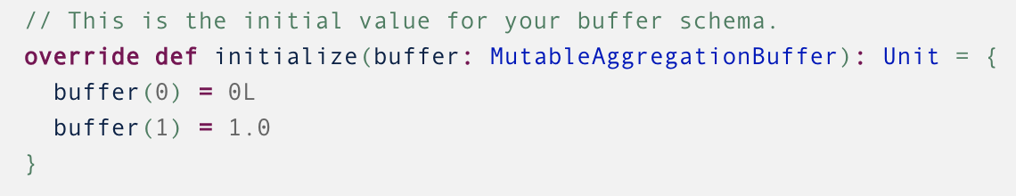
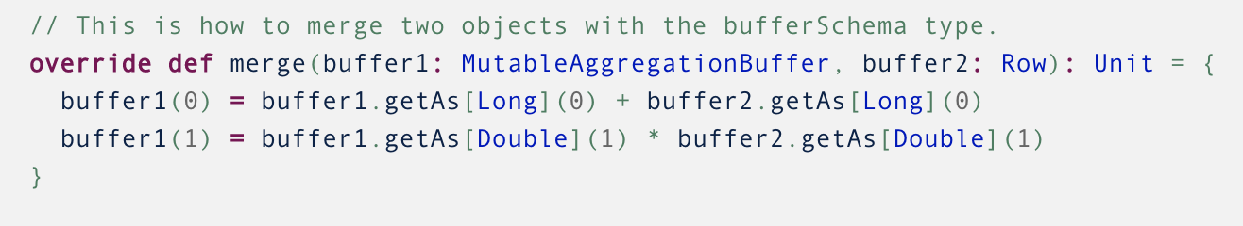
The Map/Reduce Boundary - Shuffle
And why having a Monoid is neat!
Aggregate Functions in Spark eg. sum, count trigger shuffle in order to move data locally aggregated in one node to another
Main Parts of an aggregate function
Using example from https://docs.databricks.com/spark/latest/spark-sql/udaf-scala.html
Identity
Closure + Associativity

Slide 17
The Map/Reduce Boundary - Shuffle
And why having a Monoid is neat!
Aggregate Functions in Spark eg. sum, count trigger shuffle in order to move data locally aggregated in one node to another
Local Aggregate 1
Executor
Combine
Local Aggregate 1
Local Aggregate 2
Driver
Executor
Executor
Local Aggregate 2

Slide 18
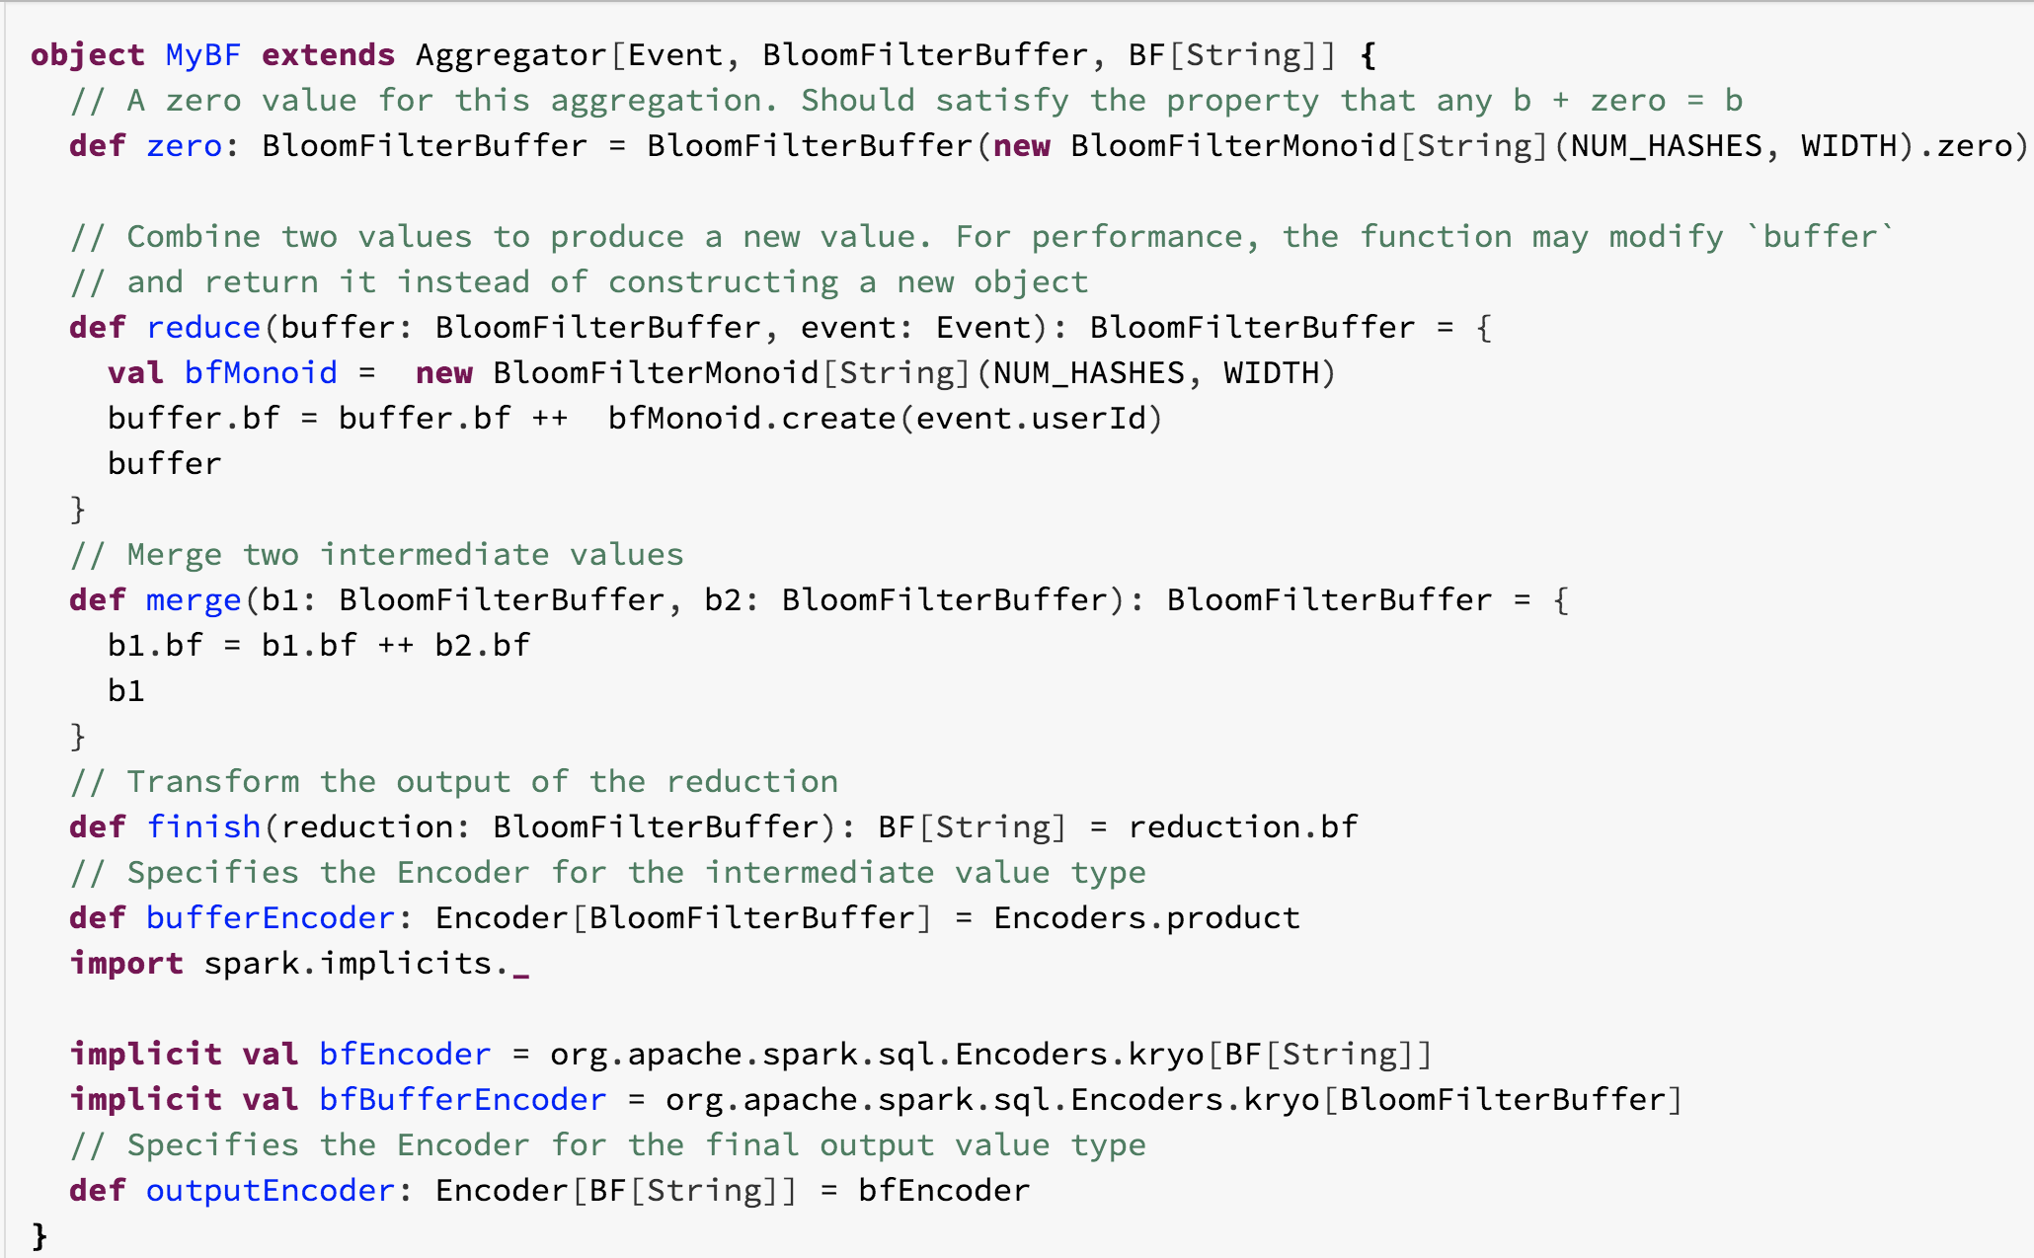

Slide 19
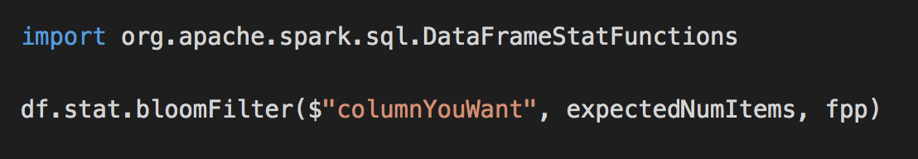
BloomFilters as Aggregate Functions
BloomF1 + BloomF2 => BloomF
BloomF1 + (BloomF2 + BloomF3) = (BloomF1 + BloomF2 ) + BloomF3
BloomF + emptyBF = BloomF

Slide 20
Solve it incrementally!
Streaming to the win!
App1
Executor
DB
Driver
Executor
App2
Executor
App3

Slide 21
Has User visited this product yet?
Ingestion Workflow
On Ingestion Microbatch,
Create BloomFilter for every Product
Map() - yield key= productId value = BF.add(userId)
Reduce () – for each key – BF.mergeInPlace(Seq[bf1, bf2, bf3])
ForeachBatch() -> Update to external Store
Switch to Notebook
df.show() some existing data
Spark Streaming Section – Bloom Filter creation

Slide 22
Has User visited this product yet?
Query Workflow
For ProductId – 1234
BF.mightContain(userID)
Switch to Notebook
Spark Streaming Section – Bloom Filter Query Example

Slide 23
Hyper Log Log

Slide 24
HLL TL;DR
How many distinct elements do you have in the Set?
Use for Set().count()
Estimate cardinalities of > 10^⁹ with a typical accuracy of 2%, using just 1.5 kB of memory
Loss free Unions!
MONOID!

Slide 25
HLL vs BF
For cardinality estimation, HLL are better at scale
https://github.com/echen/streaming-simulations/wiki/Cardinality-Estimation%3A-Bloom-Filter-vs.-HyperLogLog
For membership testing, use a BF

Slide 26



Supported Operations:
add()
merge() / union()
cardinality()
100101..011
1.5 KB
Hash = 100101..011
100101..011
1.5 KB
100101..011
1.5 KB
100101..011
1.5 KB
100101..011
1.5 KB

Slide 27
How many unique users bought Items A , B and C
Ingestion Workflow
On Ingestion Microbatch,
Create HLL for every ProductId
ForeachBatch()
Group By Product and collect local aggregation of list of users
Update to external Store
Switch to Notebook
df.show() some existing data
Spark Streaming Section – HLL creation

Slide 28
How many unique users bought Items A , B or C
Query Workflow
For ProductId – 1234 and ProductID 4589
unionHLL = HLL(1234).union(HLL(4589))
Cardinality(unionHLL)
Switch to Notebook
Spark Streaming Section – HLL Query Example
Bonus: Show intersection
How many unique users bought Items A , B AND C

Slide 29
Count-Min Sketch

Slide 30
Count Min Sketch
Space Efficient Frequency Table
Hash Table replacement
Sub-linear space instead of 0(n)
Might overcount ?
Logical Extensions of Bloom Filters
MONOID!

Slide 31
How many items has seller X sold today?
Ingestion Workflow
On Ingestion Microbatch,
Create CMS for sellerCount for date
Map() - yield key= eventType:sellerCount:date value = CMS.add(sellerId)
Reduce () – for each key – CMS.mergeInPlace(Seq[CMS1, CMS2, CMSn])
ForeachBatch() -> Update to external Store
Switch to Notebook
df.show() some existing data
Spark Streaming Section – CMS creation

Slide 32
How many items has seller X sold today?
Query Workflow
For sellerId 1234
CMS(purchase:seller:2019-12-09).frequency(1234)
Switch to Notebook
Spark Streaming Section – CMS Query Example
Bonus: Show for multiple eventTypes
SuperBonus : Estimated cardinality if we were to join purchases with visits for a day – helpful in join cost optimization

Slide 33
Usefulness?
Integrate common patterns for oft-repeated expensive queries
Quick Access to Estimates in lieu of time
Common Examples
ML Training
No need to wait for heavy batch processes to run to retrain
Page Personalization
Custom based on thresholds eg. Green background for sellers having sold > 5 items a day
Join Optimization
Check for username taken? Bad/common/leaked passwords?
Ship Sketch to Client JS to avoid unnecessary load on Server

Slide 34
More Questions?
Feel free to reach out to me at
https://www.linkedin.com/in/yeshwanth-vijayakumar-75599431
yvijayak@adobe.com
Look out for the actual implementation blog post on Profile Summaries on Adobe Tech Blogs

Slide 35
References

Slide 36



Feedback
Your feedback is important to us.
Don’t forget to rate and review the sessions.

